Slide 1

AnZ – Task 2 Synthesised Transaction Data
By: Mehul Varsha Singh
Email : mehulvarshasingh10@gmail.com
Github : https://github.com/githubmehul

Slide 2
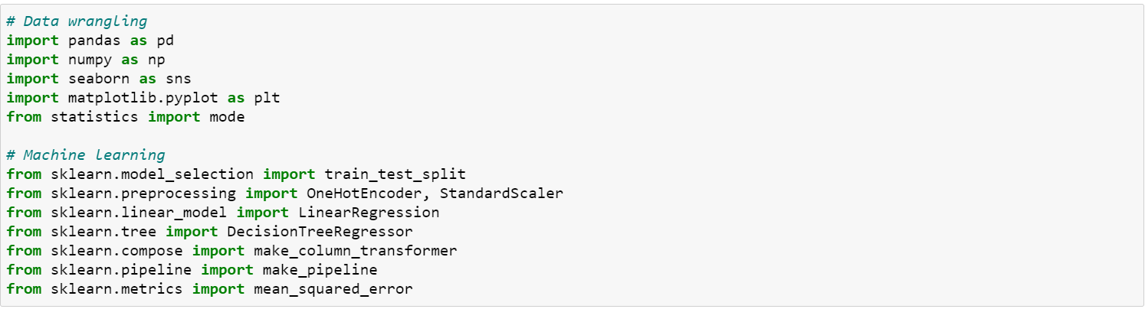
AnZ Task 2
1. Import the Libraries
2. Load the Data

Slide 3
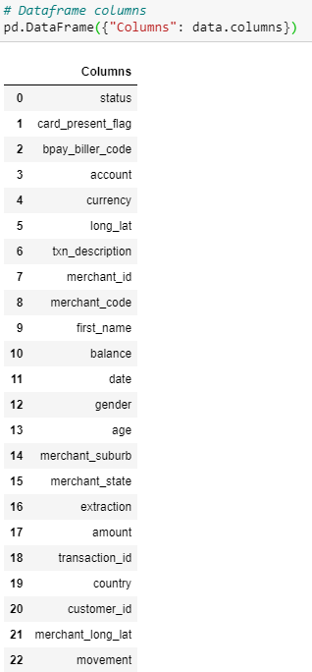
AnZ Task 2
3. The columns of the Existing Dataframe

Slide 4
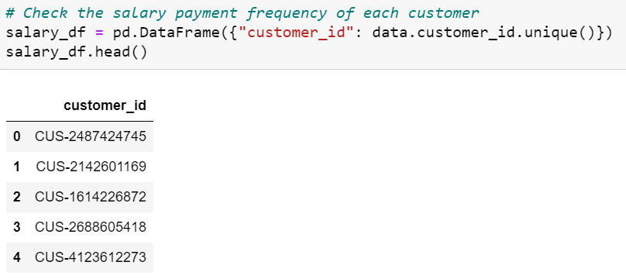
AnZ Task 2
4. Creating the Target Variable
Target Variable : Annual Salary For Each Customer
To find Target Variable : The most frequently appeared amount / The Salary Frequency * 365.25 ( We find the Weekly Salary and multiply that by 365.25 to find the Annual Salary
a. Find the Unique Customers

Slide 5
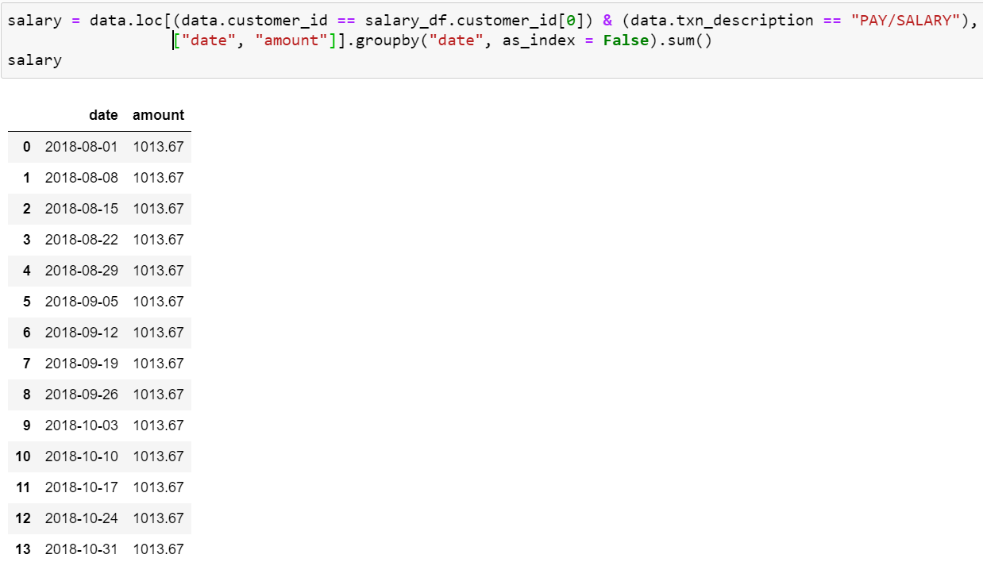
AnZ Task 2
4. Creating the Target Variable
b. Find the Date of Pay and Salary Transactions and the Amount associated with each unique Customer.

Slide 6
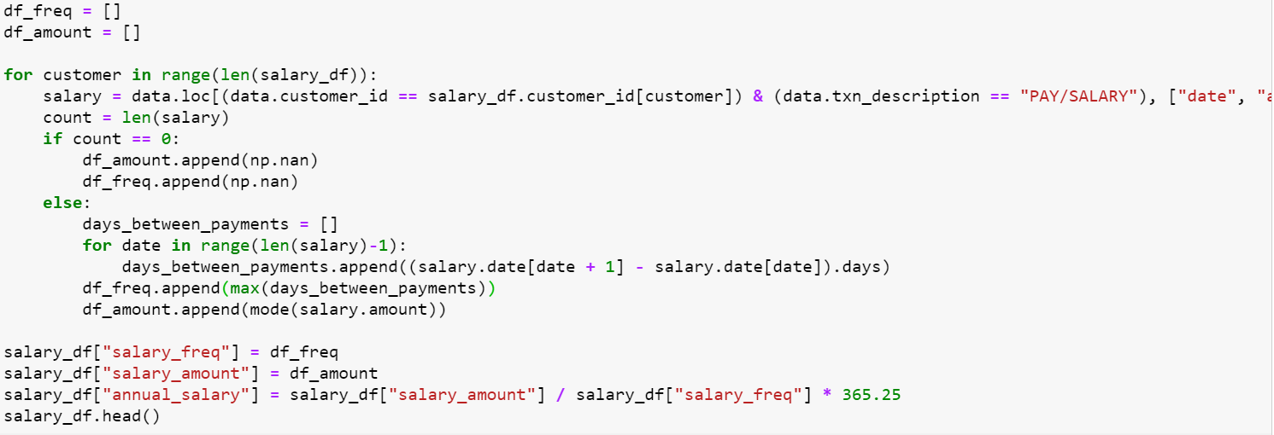
AnZ Task 2
4. Creating the Target Variable
c. For each customer in the table of Unique Customer , and the Date of Pay and Salary Transactions and the Amount associated with each unique Customer , the count is the length of the salary(100).
If the count == 0 , then append null on df_amount and df_freq.
Else , if count !=0 , for each date in the len(salary) – 1 , find the days between the each payment ((date +1(date +1) – (date(current date).days) . Append the maximum days in df_freq , and append the mode of the amount in df_amount.
The annual salary is then calculated.

Slide 7
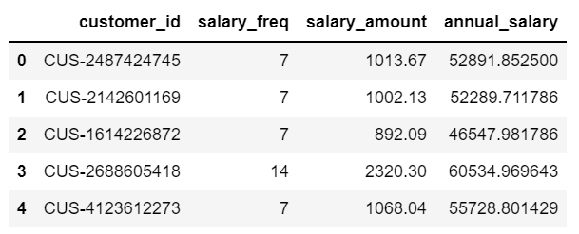
AnZ Task 2
4. Creating the Target Variable
c.

Slide 8
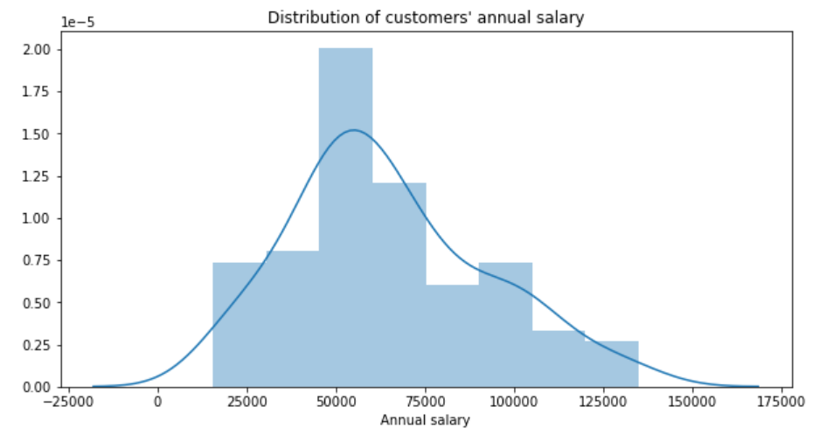
AnZ Task 2
5. Some Data Insight
a.

Slide 9
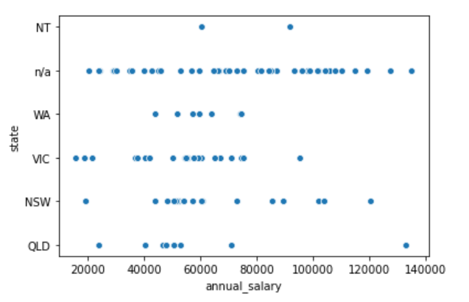
AnZ Task 2
5. Some Data Insight
b.

Slide 10
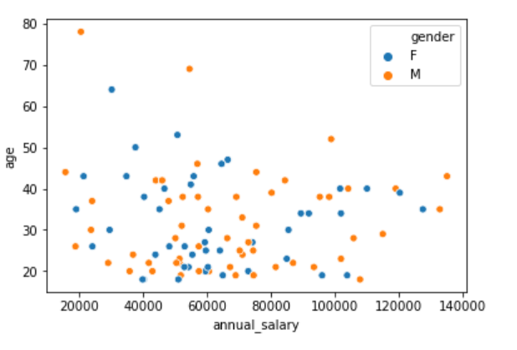
AnZ Task 2
5. Some Data Insight
b.

Slide 11
AnZ Task 2
6. Creating Predictor Variables
Predictor Variables : Variables that will help us predict the Target Variable
Some Predictor Variables are:
Average Number of Weekly Transactions
Maximum Transaction Amount
Number of Large Transactions ( >100 AUD)
Average Transaction Amount
Median Balance
State of Residence
Age
Gender

Slide 12
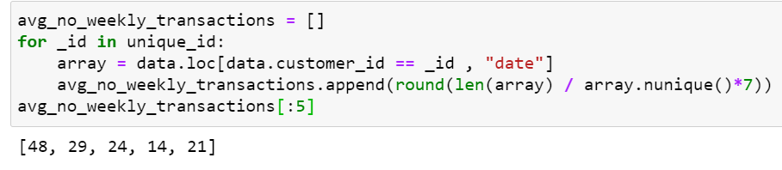
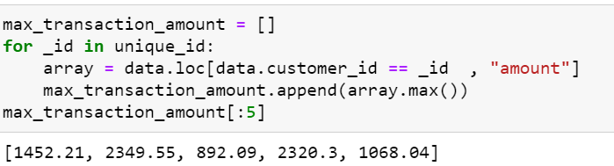
AnZ Task 2
6. Creating Predictor Variables – Unique_id is the dataframe of all the Unique Customers
Average Weekly Transactions
Maximum Transaction Amount

Slide 13
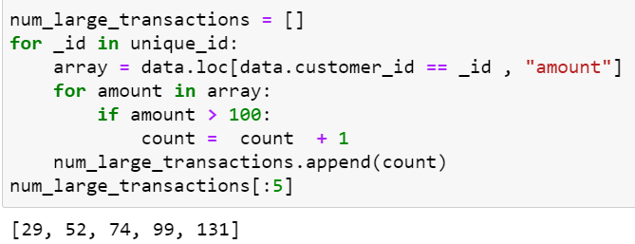
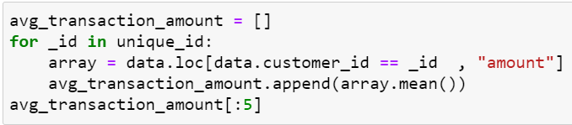
AnZ Task 2
6. Creating Predictor Variables – Unique_id is the dataframe of all the Unique Customers
Number of Large Transactions
Average Transaction Amount

Slide 14
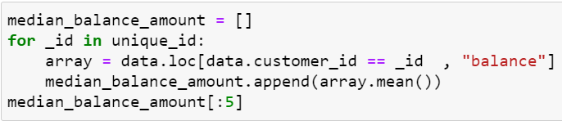
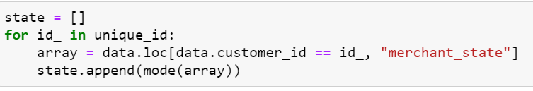
AnZ Task 2
6. Creating Predictor Variables – Unique_id is the dataframe of all the Unique Customers
Median Balance
State of Residence

Slide 15
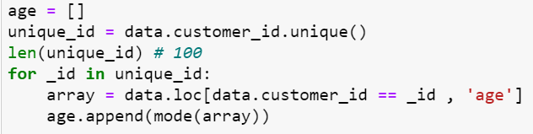
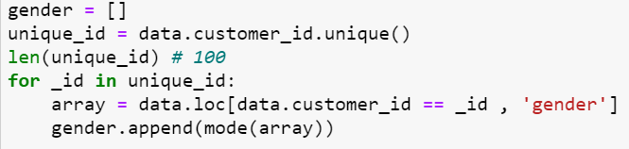
AnZ Task 2
6. Creating Predictor Variables – Unique_id is the dataframe of all the Unique Customers
Age
Gender

Slide 16
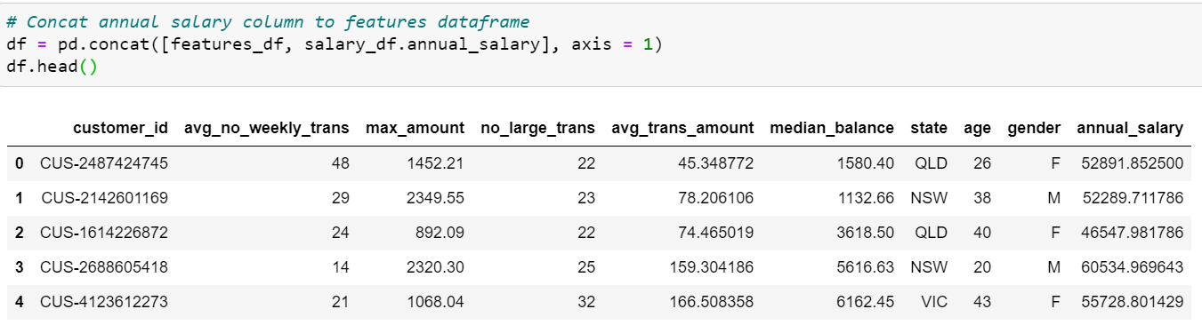
AnZ Task 2
7. Creating the Features Dataframe : No missing values found

Slide 17
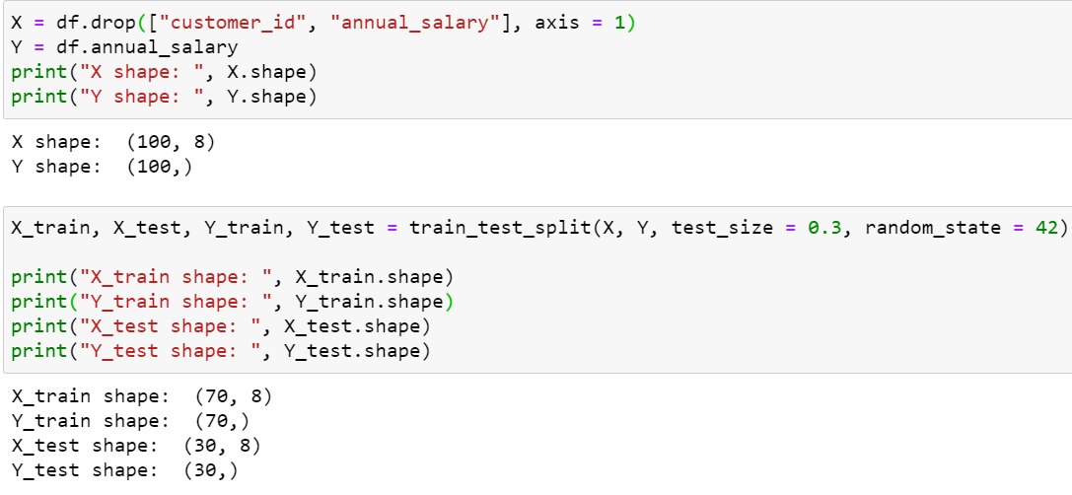
AnZ Task 2
8. Machine Learning Part
We split the Dataframe into 70% Training Set and 30% Test Set

Slide 18
AnZ Task 2
8. Machine Learning Part
Since , “State” and “Gender” are text variables , the Model cannot train on them.
So , we encode the “State” and “Gender” into one-hot encoder.
Furthermore , to ensure that the features contributes propotionally to the final prediction , we scale the numerical variables using a standard scaler.

Slide 19
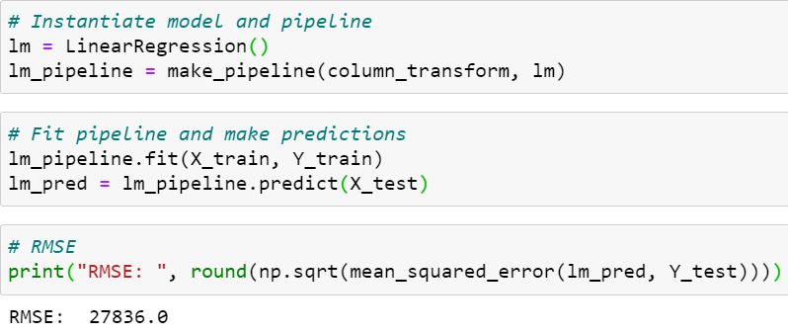
AnZ Task 2
9.Predicting the Annual Salary of Customers.
Linear Regression Model

Slide 20
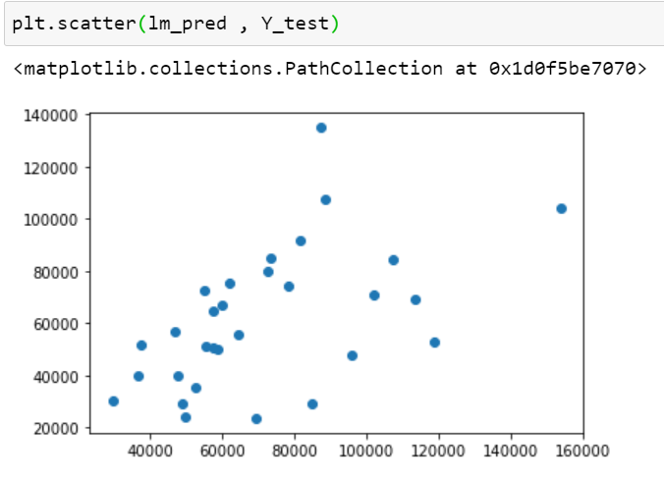
AnZ Task 2
9.Predicting the Annual Salary of Customers.
Linear Regression
Since , the RMSE is over 20000 , the model is highly inaccurate.
So , model would require more data to develop a better model.

Slide 21
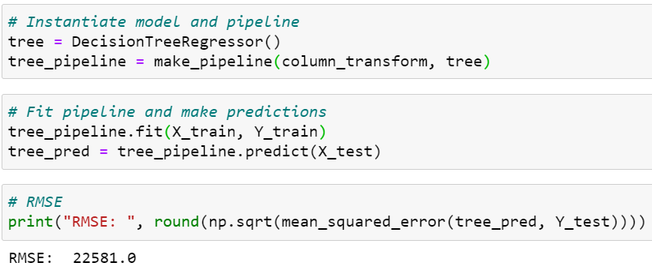
AnZ Task 2
9.Predicting the Annual Salary of Customers.
Decision Tree

Slide 22
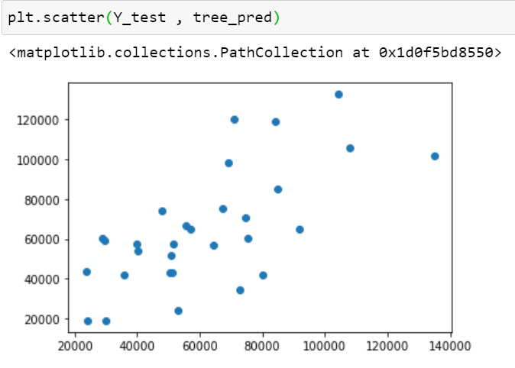
AnZ Task 2
9.Predicting the Annual Salary of Customers.
Decision Tree
Since , the RMSE is over 20000 , slightly better than the Linear Regression Model.
The model is still inaccurate , and requires more data.

